Slide 1







A Defi Game on Solana, Stake to Win Tokens and NFTs.

Slide 2

Problems We Found
Problems We Found
The huge potential of on-chain collectibles.
Solana has 0 no loss lottery project.
App stickiness.
What Do We Want to Build?
What Do We Want to Build?
GAME-LIKE
EXPERIENCE
NO LOSS
LOTTERY
GIVE AWAY USEFUL
COLLECTIBLES
Notes:
People only see numbers on Defi projects, it’s hard to make app stickiness.
There are only a few no loss lottery projects on block chain and they didn’t support Solana.
We found huge potential of on-chain collectibles and but only a few projects are trying to achieve it.
1. We want to make a product which users will usually visit it,make users love to visit our website.
2. I think the must popular no loss lottery dapp product is pooltogether on Ethereum, I can’t fond a lottery project on Solana main-net now, only Solloto on testnet. 3. Most of NFTs project I’ve seem on Solana like ApeShit Social Club or Solpunk, they only have pictures and can’t do anything else, we think we can create NFTs which are more useful and ppl will like it.

Slide 3
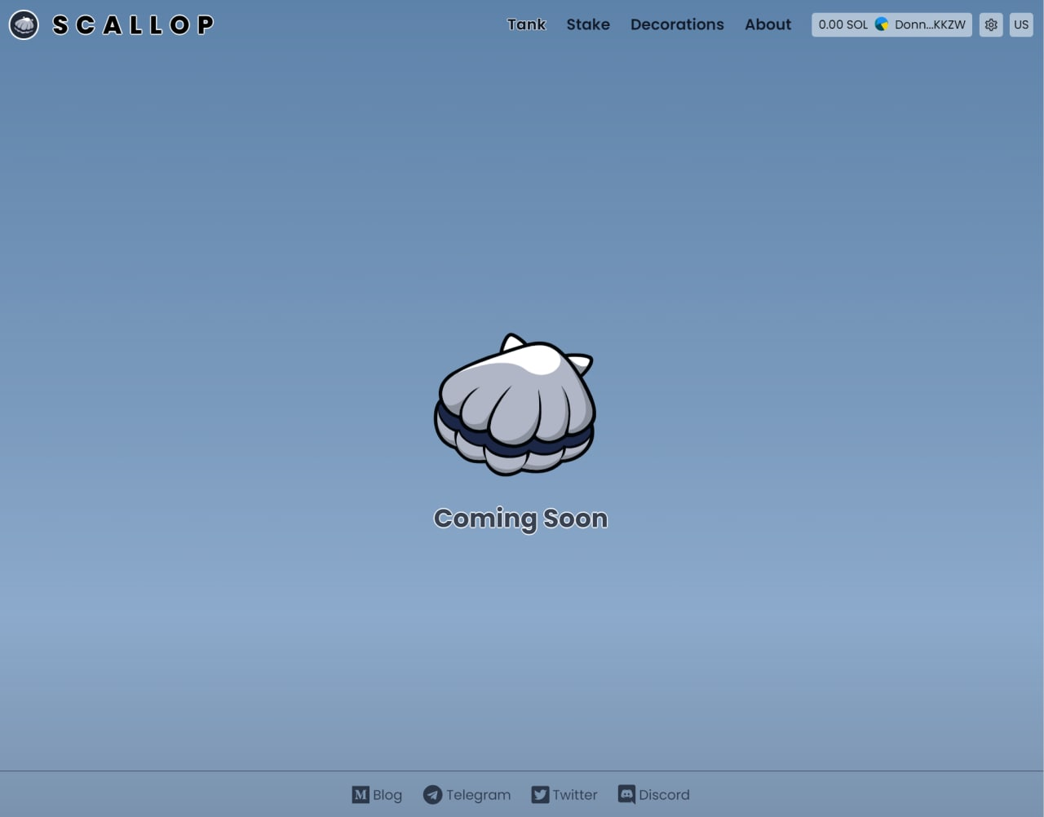
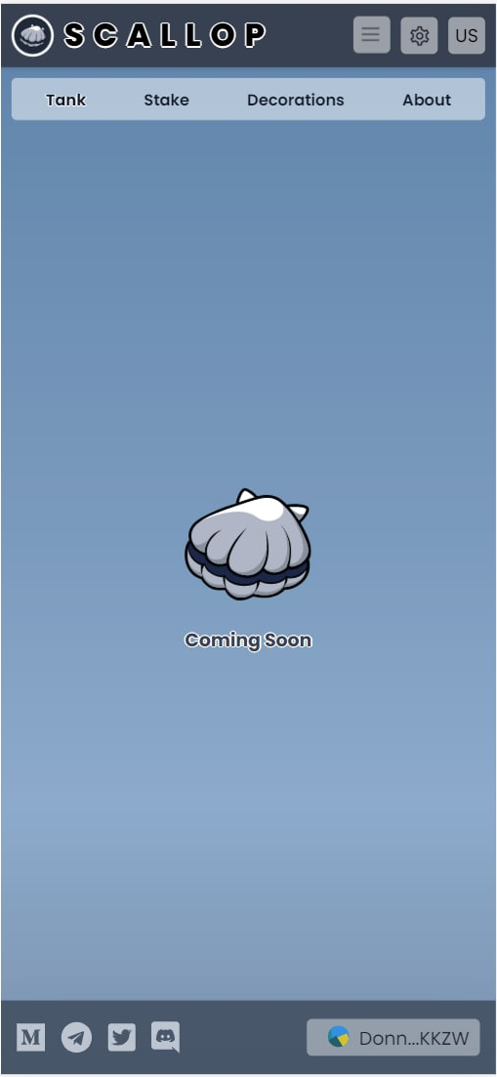
Scallop Application
Scallop Application
Notes:
This is also the current progress of our front-end, just connect to users wallet, next step will be showing tokens at Scallop tank.

Slide 4
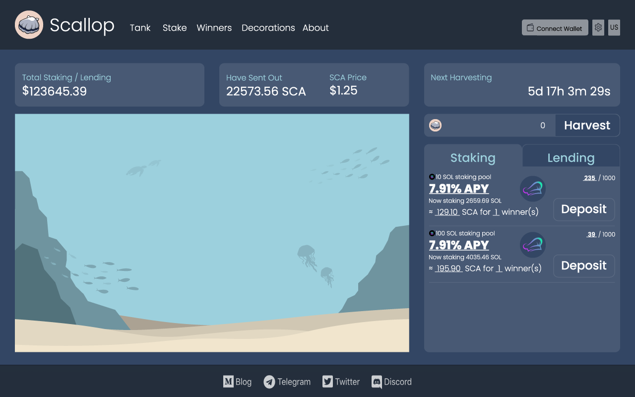
Scallop Application
Scallop Application
Notes:
This is the what opr App look like, here you will see Scallop Decorations and the Scallop you are growing.

Slide 5
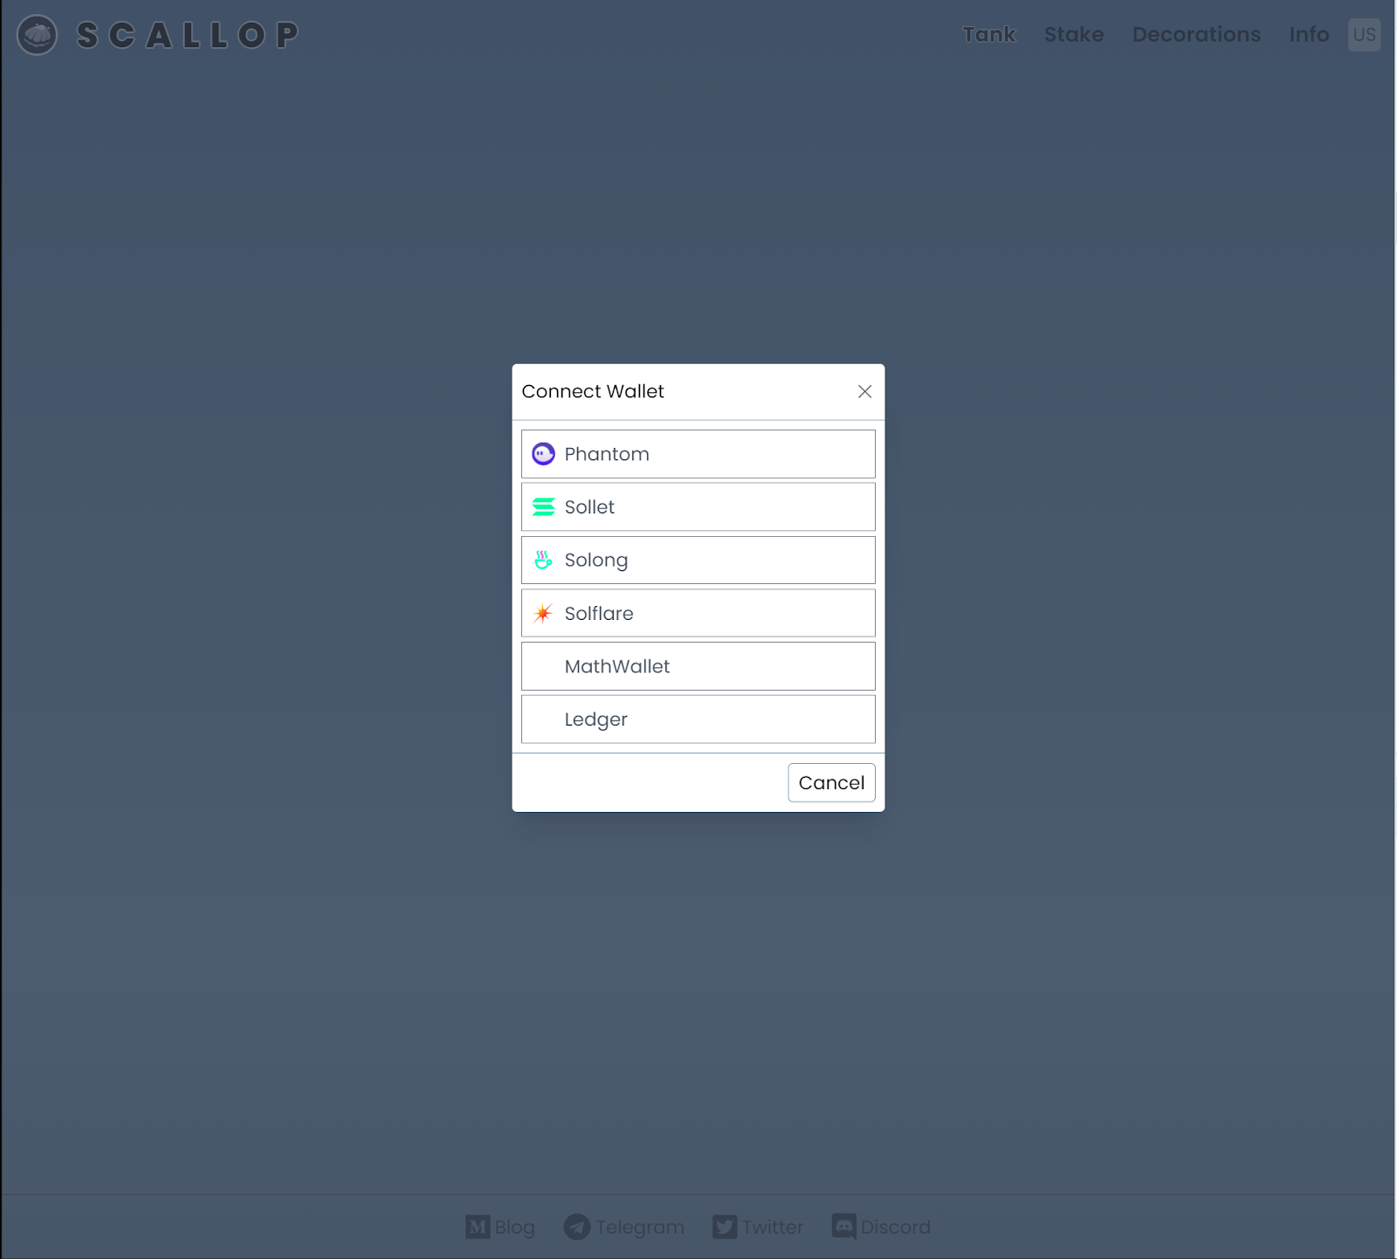
Wallet Support
Wallet Support
Phantom
Sollet
Solong
Solflare
Notes:
We are also keeping an eye on other wallet that support SPL token, like Ledger, coin98, Blocto, Bonfida.

Slide 6
Rules
Rules
= harvesting
Sun. | Mon. | Tues. | Wed. | Thur. | Fri. | Sat.
Every Friday 20:00 (GMT+8) will be the harvest time
staking over 7 days (keep staking, they can join the harvesting of next week.)
Notes:
Every Friday 20:00 (GMT+8) will be the harvest time, one (or a few) of winners chosen by program randomly will get Scallop token (SCA) with the same value of SOL staking reward.

Slide 7
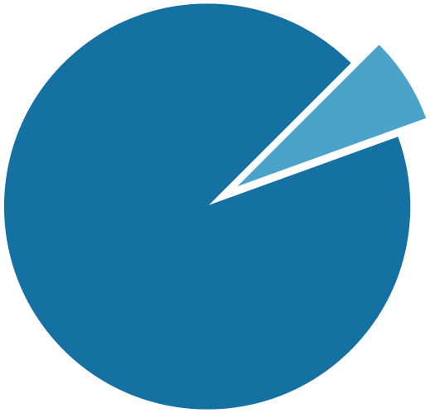
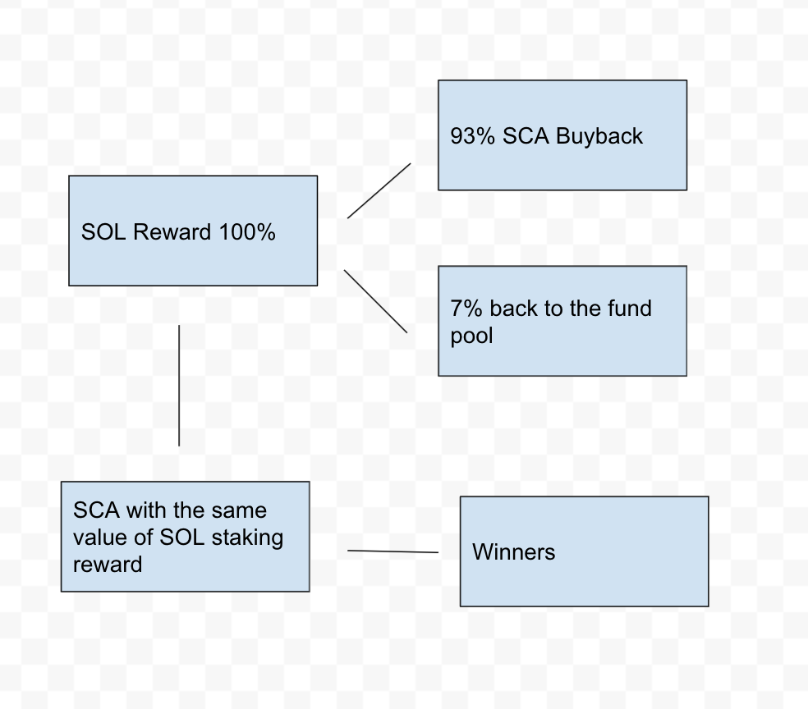
Rules
Rules
SOL REWAED USAGE
Sun. | Mon. | Tues. | Wed. | Thur. | Fri. | Sat.
7%
Every Friday 20:00 (GMT+8) will be the harvest time
BACK TO
THE STAKING POOL
93%
SCA BUYBACK
staking over 7 days (keep staking, they can join the harvesting of next week.)
There will be different tiers of pools to stake SOL:
1 SOL/1000 address
10 SOL/1000 address
100 SOL/1000 address
Notes:
We are going to use Switchboard VRF for choosing winners. We will set up more pools with different maximum address limits or different token pools for users!
We will set more pools for different tokens, like no loss lottery by staking RAY token by Raydium, it will make many projects want us to set a pool for them, it will be a win & win collab.

Slide 8
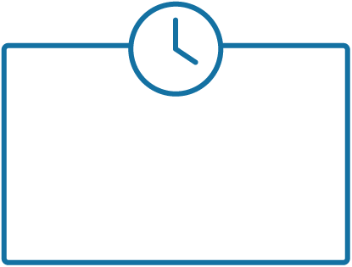
Tasks
Tasks
Join 10 SOL lottery pool over a month.
Stake more than 10K SCA over two weeks.
Offer $100 to SCA/USDC Liquidity over two weeks
extra SOL tokens Scallop decorations
Notes:
During the game users can carrying out some tasks to win something cuz we don’t want users join us for a month and get nothing. Extra SPL token rewards will be partnership token (meme token?) or some SCA
You might also have chances to win the Scallop Decorations by carrying out some tasks.

Slide 9

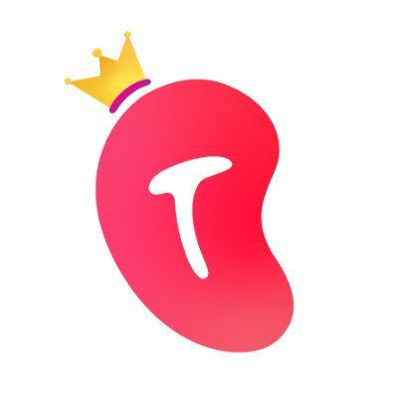
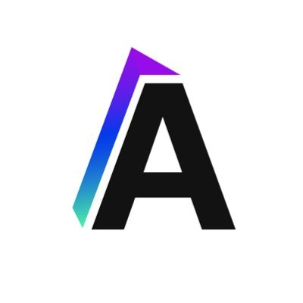



How do Scallop earn rewards?
How do Scallop earn rewards?
Priority
Secondary
Thirdly
Staking
Lending
Liquidity Mining
Marinade
Steaking.io
Acumen
Mango Markets
Orca
Serum
Notes:
At the begining, our project will choose staking to earn rewards, we will not only using 1 Solana validator, we to be more decentralized.
We are also planning to be a Solana Validator in the future.
Now the APY of SOL lending at lending projects on Solana are too low, but when we open the staking pool for another token we will use them.
There will be impermanent loss during liquidity mining, so we put them thirdly.
There will be a slide bar to let users choose which pool they can join and earn rewards.

Slide 10
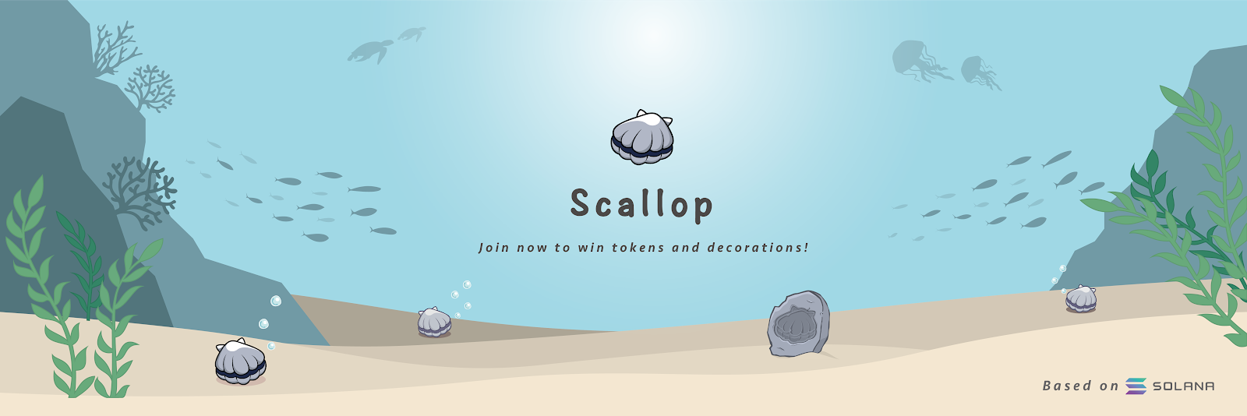

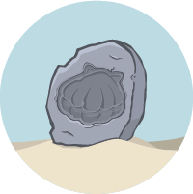



Scallop Decorations
Scallop Decorations
In Scallop, if you have some tokens or NFTs which we listed in your address, you can show it in Scallop tank to make your tank more beautiful and colorful, which means you can call Scallop a small NFTs ecosystem.
We will not only list tokens minted by us, we would also like to list tokens by other projects like Orca Collectibles by Orca.
Notes:
I think this will be one of the most attractive part of our project, we can make many on-chain collectibles from other project more useful and valueable.

Slide 11
Scallop Decorations
Scallop Decorations
Some kinds of Scallop Decorations are unlimited , but we won't mint it without any announcement.
Holding some kinds of Scallop Decorations might let you get more extra tokens in some events.
We will show more & more tokens in Scallop tank in the future!
There will be a Scallop Decorations market and a Decorations illustrated book.

Slide 12
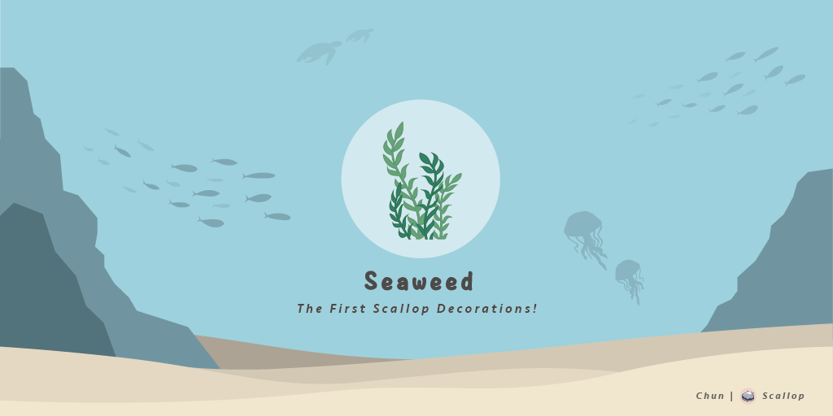
Seaweed
Seaweed
First Scallop Decorations and the most common Scallop Decorations in every Scallop Tanks!
First Scallop Decorations and the most common Scallop Decorations in every Scallop Tanks!
Address : SeawdHf3NHG6gxCrezQxr5oJAHTLJd6JsQxxd144yaz
Symbol : Seaweed
Name : Scallop Seaweed Decorations
Decimals : 0
Supply : 338 (Unlimited)
Rarity : ★✰✰✰✰
Notes:
I am also a 5 years experience scuba diver so we can tell people many story about ocean life and it really help for buliding this project like when we want to create some ocean-theme tokens to be our Scallop Decorations.

Slide 13
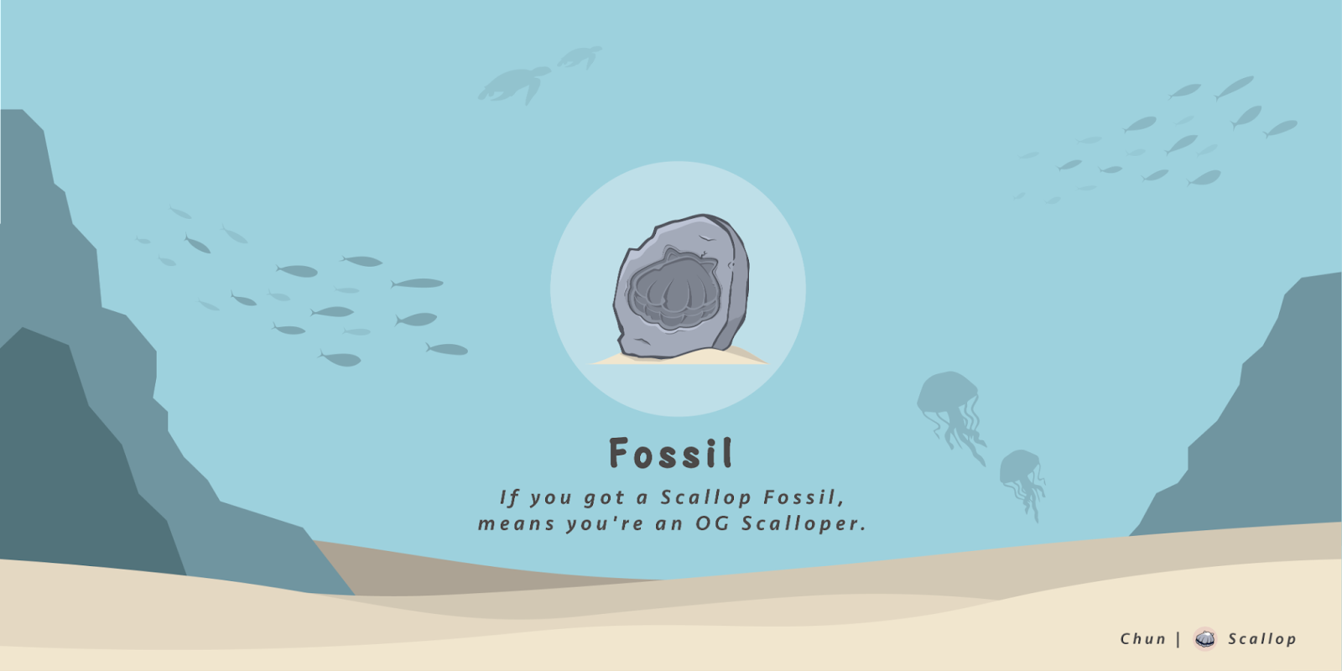
Scallop Fossil
Scallop Fossil
The first limited Scallop Decorations. Users who have a Scallop Fossil means they are an OG Scalloper and are our early supporters.
The first limited Scallop Decorations. Users who have a Scallop Fossil means they are an OG Scalloper and are our early supporters.
Address :FossiLkXJZ1rePN8jWBqHDZZ3F7ET8p1dRGhYKHbQcZR
Market id :NF5PoXovc9wpWMPMrGeCQSmJRAEEUFCR3UZGVHTonf9
Symbol : Fossil
Name : Scallop Fossil Decorations
Decimals : 0
Supply : 400 (Limited)
Rarity : ★★★★★
Notes:
only for who voted us at solana hackathon asia

Slide 14

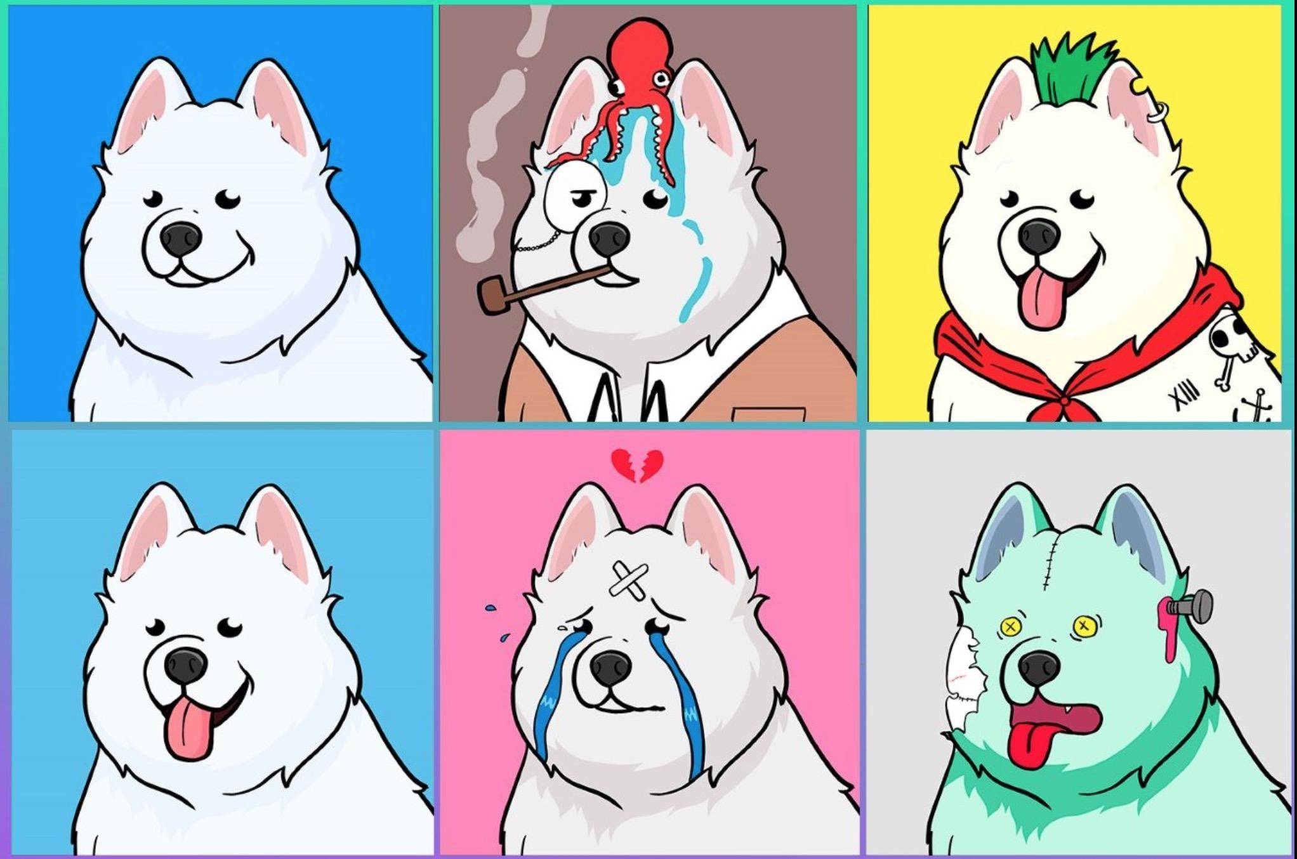
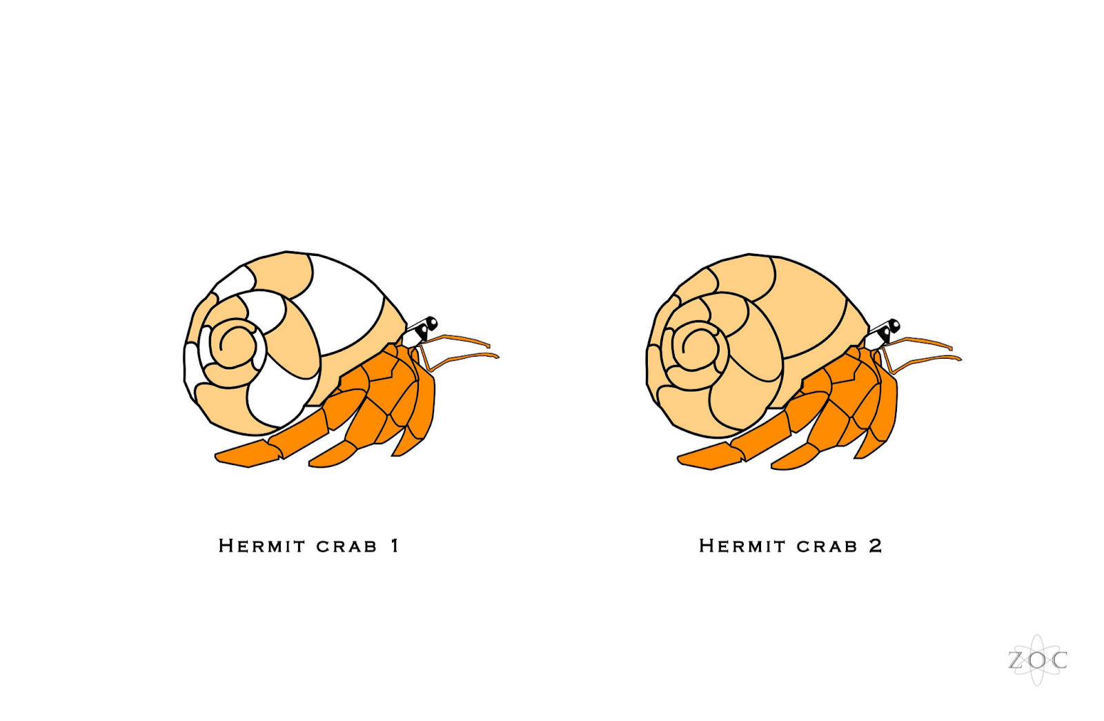
Scallop
NFTs Decorations
Scallop
NFTs Decorations
Notes:
We will mint NFTs (Non-Fungible tokens) by using Metaplex,they are going to be Scallop Decorations too, like one and only hermit crab NFTs,
Total supply of each Scallop NFTs Decorations will be limited.
We will sold it or let users to bid it, part of income will also be SCA buyback.

Slide 15
Decorations Eggs (Gashapon system)
Decorations Eggs (Gashapon system)
Notes:
Users can buy Scallop Decorations Eggs to get a random Scallop Decorations or Scallop NFTs Decorations.
We will announce how many kinds and the amount of Scallop Decorations are in the Scallop Decorations Eggs.
Scallop Decorations Eggs only sells during events and it will be limited.
We will sold it or let users to bid it, part of income will also be SCA buyback.
this is the first Gashapon system on Solana

Slide 16




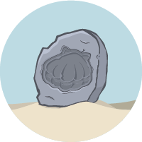
Road Map
Road Map
Q2 2021
15th May. 2021
Scallop Born
Solana Hackathon
First Decorations
Seaweed
Q3 2021
SCA token launch
Launch Scallop on test-net
First SCA airdrop
Scallop Fossil Decorations

Slide 17
Q4 2021
Launch Scallop on main-net
SCA token staking pool
SCA/USDC Swap, Liquidity pool
Nautilus Decorations (Bidding event)
More ways to let the funds to earn rewards
Q1 2022
Scallop shop
Second SCA airdrop
Scallop NFTs Decorationsz
Another token Scallop pool
Q2 2022
Vote with your SCA
Scallop Decorations Eggs

Slide 18
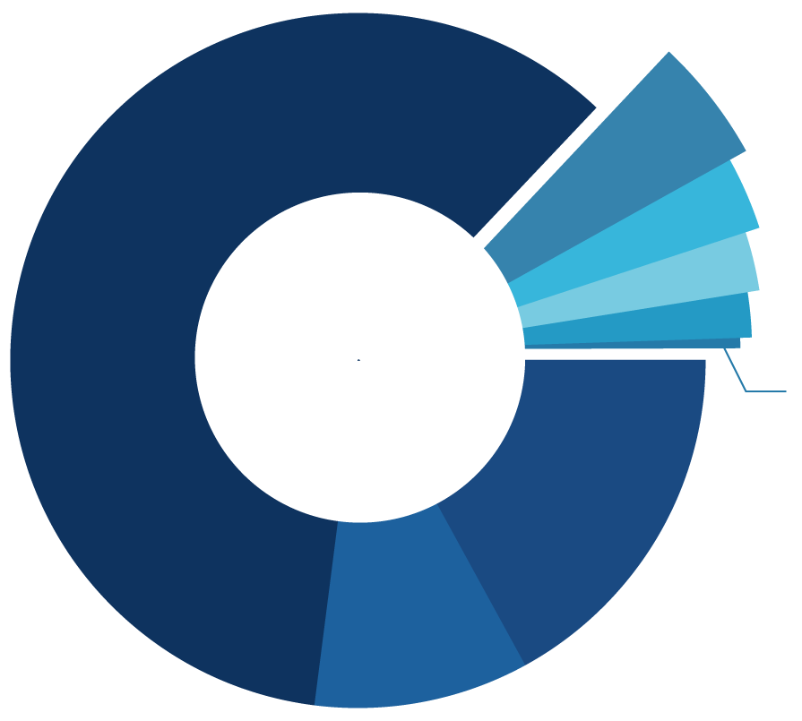
SCA Tokenomic
SCA Tokenomic
GAMING
& STAKING REWARD
5% MARKET / LIQUIDITY
3% MARINE CONSERVATION GROUP
2.5% ECOSYSTEM / COMMUNITY
60%
2% ADVISER / HELPER
0.5% AIRDROP
17%
CORE TEAM
ALLOCATION | PERCENTAGE | NUMBER OF TOKENS
GAMING & STAKING REWARD | 60.00% | 1,440,000,000
INVESTORS | 10.00% | 240,000,000
CORE TEAM | 17.00% | 408,000,000
MARKET / LIQUIDITY | 5.00% | 120,000,000
ADVISER / HELPER | 2.00% | 48,000,000
MARINE CONSERVATIO GROUP | 3.00% | 72,000,000
ECOSYSTEM / COMMUNITY | 2.50% | 60,000,000
AIRDROP | 0.50% | 12,000,000
TOTAL | 100.00% | 2,400,000,000
10%
INVESTOR
SCA buyback
(SCA is a deflationary token)
93% of SOL staking reward at Scallop pool.
Part of income of Scallop NFTs Decorations.
Part of income of Scallop Decorations Eggs.
SCA burning will be quarterly.

Slide 19

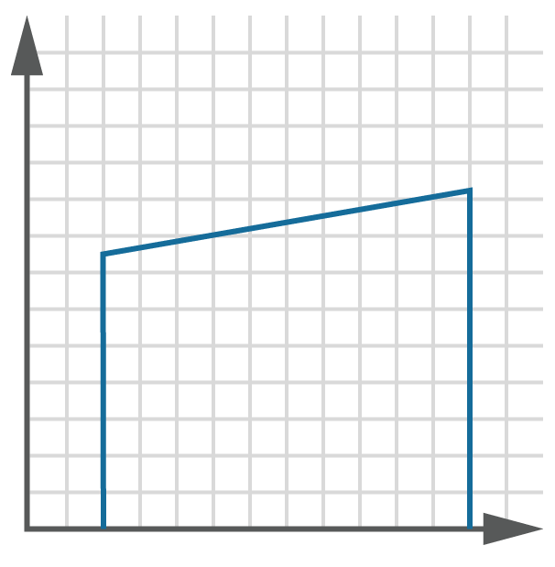

60%
GAMING & STAKING REWARD
20%
10%
10%
20%
10%
will be minted at the beginning.
will mint and send to the on-chain program quarterly for 2 years.
Unlock%
10%
INVESTOR
17%
CORE TEAM
Locked on-chain with a cliff of 6 months and 3 year linear unlocking.
5%
TIME
3%
5%
MARKET / LIQUIDITY
2.5%
60%
2%
10%
0.5%
40%
10%
40%
10%
will be minted at the beginning.
will join the market quarterly for one and a half year.
17%
10%

Slide 20
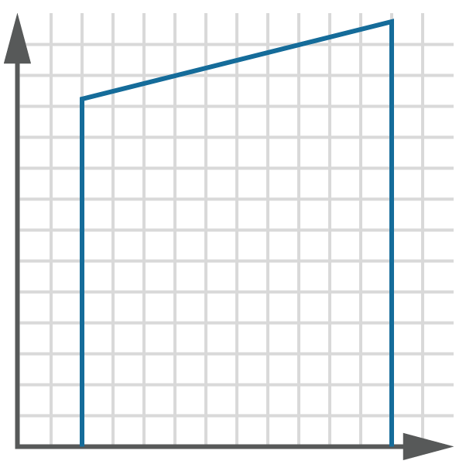
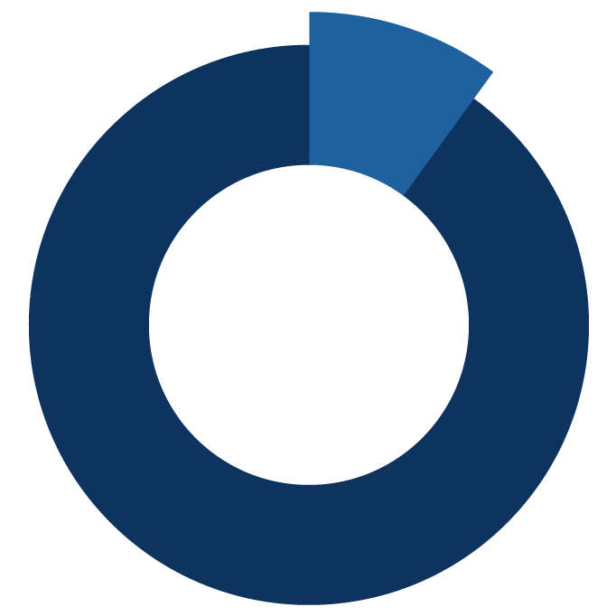

2%
ADVISER / HELPER
Unlock%
locked on-chain with a cliff of 3 months and 2 years linear unlocking.
TIME
3%
MARINE
CONSERVATION
GROUP
2.5%
ECOSYSTEM/COMMUNITY
10%
5%
10%
of the existing will be unlocked quarterly.
90%
3%
0.5%
ARDROP
2.5%
60%
2%
0.5%
50%
50%
We will mint 50% at Q3 2021, another 50% will be minted at Q1 2022.
17%
10%

Slide 21
Token Utility
Token Utility
SCA token is designed to shift towards governance.
We are focusing on some interesting voting projects on Solana.
Once this is ready, we will shift governance to token holders.
This will allow holders to vote on some subject like：
Treasury Usage
Scallop Improvements
Set up new SPL token tank
Offer SCA/USDC Liquidity
Stake SCA to earn more SCA
Users can choose different locked day limits for staking bonuses:
no limit - no bonus
15 days - 10% bonus
30 days - 20% bonus
60 days - 30% bonus
You can use SCA to buy Scallop Decorations.

Slide 22



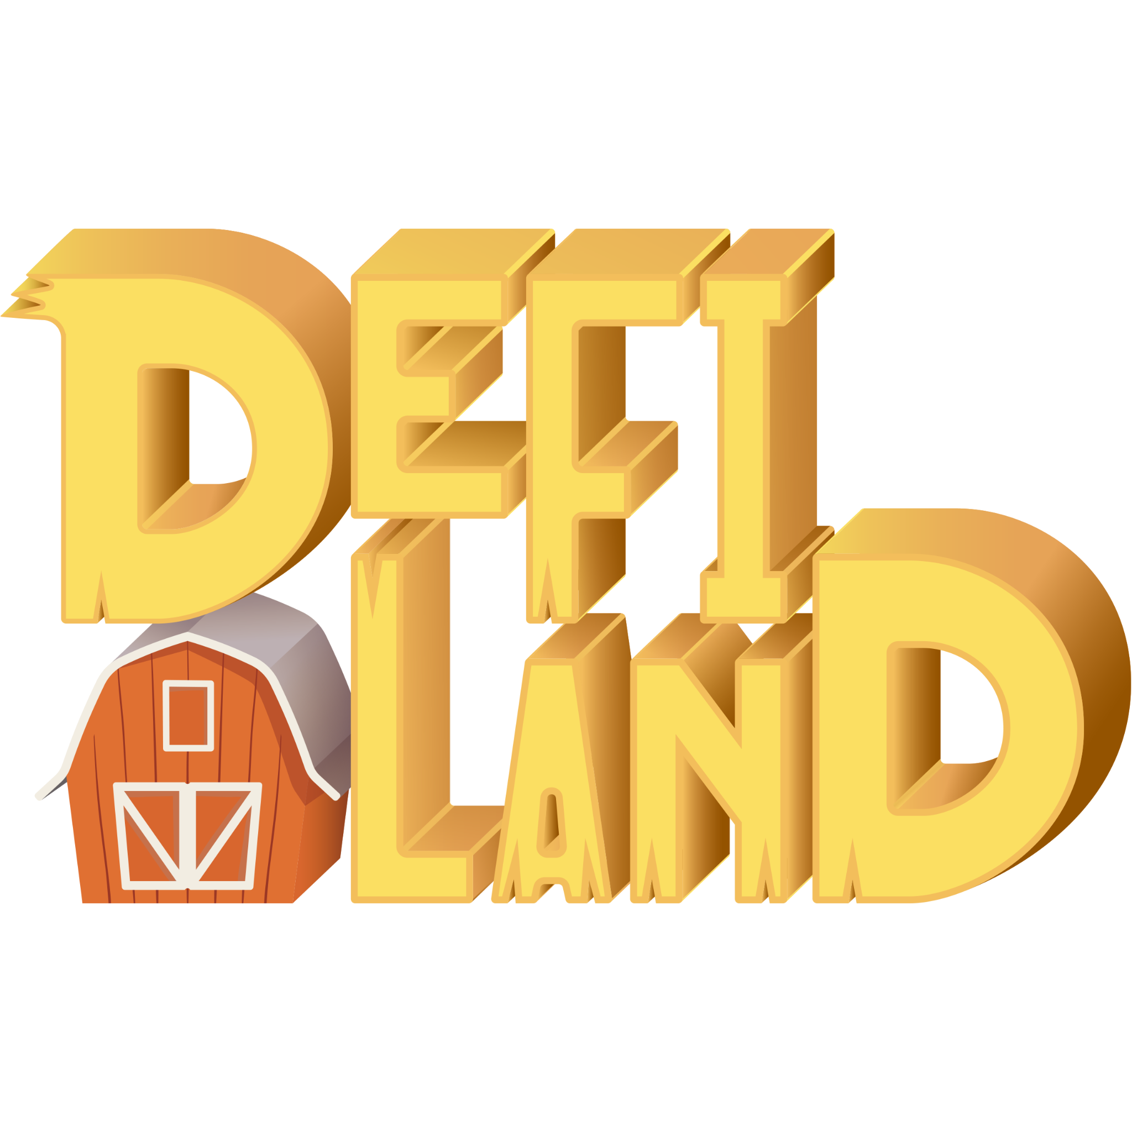


Competitors
Competitors
There will be 3 kinds of Scallop competitors.
There will be 3 kinds of Scallop competitors.
Lottery
Defi Gaming
NFTs
Pooltogether
Sushi Warrior
ApeShit Social Club
Sollotto
Defi Land
Sollamas NFT

Slide 23
Scallop Q&A Time
Scallop Q&A Time

Slide 24
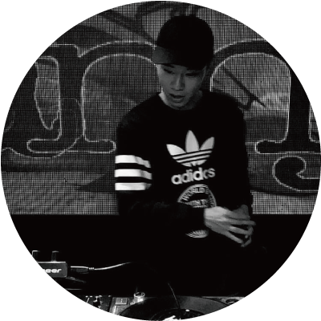




Team
Team
Kriss | Donnie | Larry
Founder | Co-founder Full-stack | Co-founder On-chain program
Chun | Zoc
Art director | Designer

Slide 25
About Us
About Us
Kriss | Donnie
4 years experience security engineer. 4 years experience in gaming industry. 4 years experience in crypto. 5 years experience scuba diver. 10 years experience DJ. Served as a senior security engineer at one of bigest web gaming company in Asia. | 4 years experience full-stack engineer. 4 years experience in gaming industry. 4 years experience in crypto.

Slide 26
About Us
About Us
Larry
5 years experience blockchain engineer. 2 years experience in blockchain gaming industry. 8 years experience in software development. Served as a core engineer in Canada’s largest bank blockchain laboratory, a decentralized credentials verification platform, and a gaming blockchain protocol, etc. Extensive experience in blockchain, KYC, decentralized applications, smart contract programming. Bachelor of Engineering Science, University of Toronto Scaling Eth hackathon Winner Hackathon Russia Winner

Slide 27
About Us
About Us
Chun | Zoc
3 years experience in art design. Focus on graphic design. | 3 years experience in art design. Focus on 3D modeling and graphic design.

Slide 28
Thanks for listening
Thanks for listen

